Slide 1
Inventories - Accounting Principles
2022. 5.
Yangin Yoon

Slide 2
Recap the previous class
First-in, first out (FIFO)
- First purchase amount is the first cost assigned to cost of goods sold
- Ending inventory is based on the latest purchase amounts
Last-in, first-out (LIFO)
- Costing is the opposite of FIFO
- Last purchase amount goes immediately to cost of goods sold
- Ending inventory is based on the oldest purchase amount
Weighted-Average Cost
- Based on the average unit amount of inventory during the period

Slide 3
Recap the previous class
The ABC OIL started its business on 20X2. 1.10.
This is a gasoline station, and it sells only one type of gasoline.
It has bought gasoline from its suppliers. The company use FIFO methods.
20X2. 2. 1. the shop sold 350 liters. How much is the cost of goods?
100 * 20
+ 250 * 15 = 2000 + 3750 = 5,750
20X2. 3. 26. the shop sold 600 liters. How much is the cost of goods?
50 * 15
+ 500*18
+ 50 *16 = 750 + 9000 + 800 = 10050
Date | Amounts (liters) | Unit price ($/liter) | Total Value
20X2. 1. 15. | 100 | 20 | 2,000
20X2. 1. 25. | 300 | 15 | 4,500
20X2. 2. 20. | 500 | 18 | 9,000
20X2. 3. 25. | 400 | 16 | 6,400

Slide 4
Recap the previous class
The ABC OIL started its business on 20X2. 1.10.
This is a gasoline station, and it sells only one type of gasoline.
It has bought gasoline from its suppliers. The company use FIFO methods.
20X2. 2. 1. the shop sold 350 liters. How much is the cost of goods?
20X2. 3. 26. the shop sold 600 liters. How much is the cost of goods?
Date | Amounts (liters) | Unit price ($/liter) | Total Value
20X2. 1. 15. | 100 | 20 | 2,000
20X2. 1. 25. | 300 | 15 | 4,500
20X2. 2. 20. | 500 | 18 | 9,000
20X2. 3. 25. | 400 | 16 | 6,400
Cash XXX
Revenue XXXX
Cost of goods 5,750
Inventory 5,750
Cash XXX
Revenue XXXX
Cost of goods 10,050
Inventory 10,050

Slide 5
Measurement of Inventories
IFRS Standard
- IAS 2 Inventories
- This is equivalent to “기업회계기준서(K-IFRS) 제1002호 재고자산.”
Paragraph 9
- Inventories shall be measured at the lower of cost and net realizable value.
Paragraph 10
- The cost of inventories shall comprise all costs of purchase, costs of conversion and other costs incurred in bringing the inventories to their present location and condition.
http://www.kasb.or.kr/fe/accstd/NR_list.do?sortCd=K-IFRS

Slide 6
Measurement of Inventories
ABC OIL bought gasoline from its supplier. ABC OIL paid $100 to its supplier. In addition, ABC OIL paid $10 to a delivery company for oil transportation. All transactions occurred with cash.
- Provide the journal entry.
Paragraph 10 – “The cost of inventories shall comprise all costs of purchase, costs of conversion and other costs incurred in bringing the inventories to their present location and condition.”
Journal Entry
Inventory $100
Cash $100
Transportation expense $10
Cash $10
Inventory $10
Transportation expense $10
→
Inventory $110
Cash $100
Cash $10

Slide 7
Measurement of Inventories
ST Toy bought raw material from its supplier. ST Toy paid $200 to its supplier. In addition, ST Toy paid $80 to the factory workers as wage. The accounting department employees of ST Toy were also paid $40. ST Toy manufactured toys and used up all of its raw material. All transactions occurred with cash.
Paragraph 10 – “The cost of inventories shall comprise all costs of purchase, costs of conversion and other costs incurred in bringing the inventories to their present location and condition.”
Journal Entry
Raw material (asset) $200
Cash $200
Factory worker salary expense $80
Cash $80
Acct worker salary expense $40
Cash $40
Product (asset, inventory) $200
Raw material (asset) $200
Product (asset , inventory) $80
Factory worker salary expense $80

Slide 8
Measurement of Inventories
ST Toy bought raw material from its supplier. ST Toy paid $200 to its supplier. In addition, ST Toy paid $80 to the factory workers as wage. The accounting department employees of ST Toy were also paid $40. ST Toy manufactured toys and used up all of its raw material. All transactions occurred with cash.
The toys can be sold $500 in the market.
- Provide the general entry.
Paragraph 9 – “Inventories shall be measured at the lower of cost and net realizable value.” → $280
Journal Entry
→ No additional journal entry is needed.

Slide 9
Measurement of Inventories
ST Toy bought raw material from its supplier. ST Toy paid $200 to its supplier. In addition, ST Toy paid $80 to the factory workers as wage. The accounting department employees of ST Toy were also paid $40. ST Toy manufactured toys and used up all of its raw material. All transactions occurred with cash.
The toys can be sold $100 in the market.
- Provide the general entry.
Paragraph 9 – “Inventories shall be measured at the lower of cost and net realizable value.” → $100
Journal Entry
Inventory write-down (expense) $180
Product (asset) $180

Slide 10
Measurement of Inventories
ST Toy bought raw material from its supplier. ST Toy paid $200 to its supplier. In addition, ST Toy paid $80 to the factory workers as wage. The accounting department employees of ST Toy were also paid $40. ST Toy manufactured toys and used up all of its raw material. All transactions occurred with cash.
The toys can be sold $100 in the market.
- Provide the general entry.
Paragraph 9 – “Inventories shall be measured at the lower of cost and net realizable value.”
(K-GAAP 7 – Paragraph 7.20)
Journal Entry
Inventory write-down (expense) $180
Accumulated loss (asset) $180
http://www.kasb.or.kr/fe/accstd/NR_list.do?sortCd=G-COMPANY
https://dart.fss.or.kr/dsaf001/main.do?rcpNo=20220323000843

Slide 11
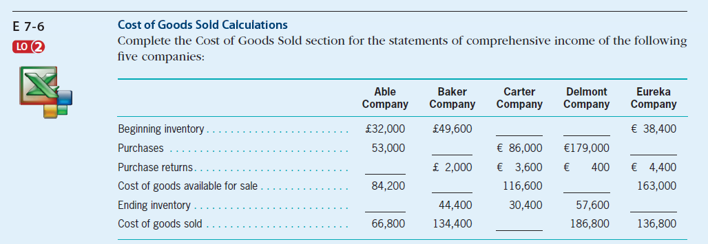
Inventories (exercise)
Self-Study Material (in the e-class, Chapter #7)
© 2017 Cengage Learning, Principles of Financial Accounting, 2/E (IFRS Edition)

Slide 12
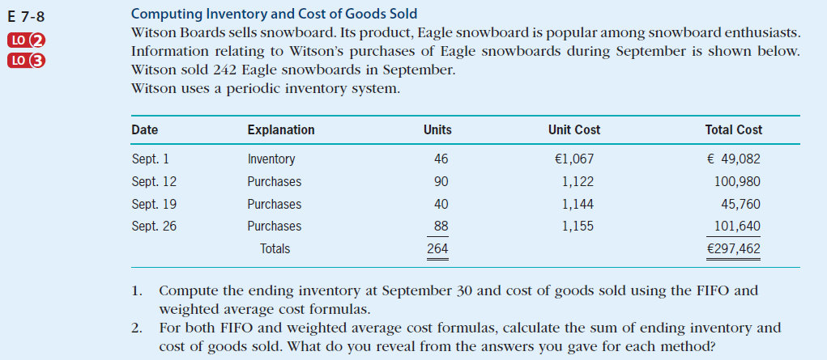
Inventories (exercise)
Self-Study Material (in the e-class, Chapter #7)
© 2017 Cengage Learning, Principles of Financial Accounting, 2/E (IFRS Edition)

Slide 13
Any Questions?

